Slide 1
Traffic Signal at Bethel and Almond
City of Sanger
Federal Project Number: CML-5197(043)
FTIP: LSTMP839

Slide 2
Overview
Project Description
Project Location
Purpose and Need
Project Listing in the FTIP/CTIPS
Traffic Data
Project Schedule
Project-level Conformity Summary

Slide 3
Project Description
At the intersection of Bethel Ave and Almond Ave; Install a new three-phase traffic signal system.
Currently, there are high traffic volumes on Bethel Avenue at Almond Avenue, resulting in long queue times for the intersection.
Installing a new traffic signal at the intersection improves the level of service, reduces queues and idling time at the intersection, and provides safety improvements for pedestrians to cross to the intersection.
Project consists of a No-Build (no signal improvements) and One Build Scenario (with signal improvements)
Project does not meet the criteria for an exempt project under 40 CFR 93.126 or 93.128.

Slide 4
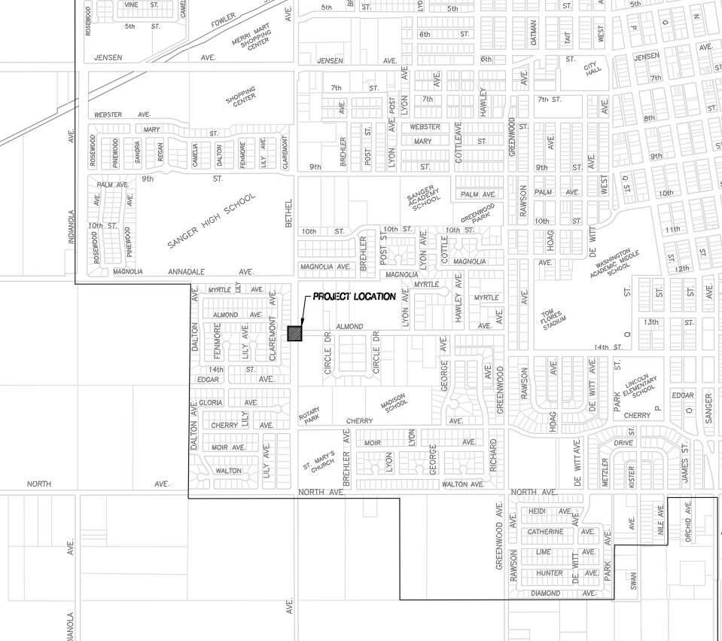
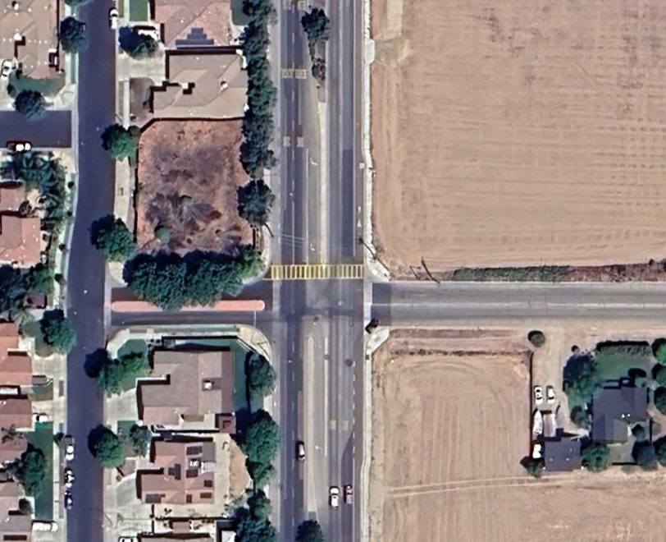
Location

Slide 5
Purpose and Need
Need
Currently there are high traffic volumes on Bethel Avenue at Almond Avenue, due to its location Sanger High School, resulting in long queue times for east and west legs trying to get onto Bethel Avenue.
Existing Level of Service (2025) – LOS F during AM Peak Hour and LOS F during the PM Peak Hour and existing Delay – 696 seconds and 82 seconds during AM and PM peak hours
A secondary benefit would provide an enhancement for pedestrians to safely cross the road. There was a recent fatal accident with a motorist and pedestrian attempting to cross Bethel Avenue.
Purpose
Installation of a new traffic signal at the intersection of Bethel Avenue and Almond Avenue.
Installing the traffic signal system will not only significantly reduce delay and increase the level of service but also bring much-needed safety improvements for pedestrians crossing east-west on Bethel Avenue where it is currently uncontrolled.
New level of service (LOS) based on existing peak hours (with signal improvements in 2025) – LOS C during the AM peak hour and LOS B in the PM peak hour and new delay (with signal improvements) – 29.9 seconds and 13.1 second during AM and PM peak hours

Slide 6
Project Listing in the TIP
The proposed project (FTIP ID: LSTMP839) is listed in the 2025 Fresno Transportation Improvement Program.
The scope of the proposed project is consistent with the project description in the 2025 FTIP.

Slide 7
Modeling and Tables
 | 2025 (NO-BUILD) | 2025 (BUILD) | 2046 AADT (NO-BUILD) | 2046 AADT (BUILD)
AADT | 6572 | 6572 | 15662 | 15662
% Trucks | 18% | 18% | 34% | 34%
Truck AADT | 1168 | 1168 | 5283 | 5283
LOS & Delay | AM - F (696.3 Seconds) PM - F (82.2 Seconds) | AM - C (29.9 Seconds) PM - B (13.1 Seconds) | AM - F (90107.4 Seconds) PM - F (4074.9 Seconds) | AM - F (341.3 Seconds) PM - F (126.7 Seconds)
AADT for 2025 and 2046 future years is the same for no-build and build.
Y&H coordinated with Fresno COG and COG provided traffic date from their travel demand model. Y&H then applied the incremental method to traffic counts conducted to get forecasted traffic and determine the level of service of the intersection for both 2025 and 2046 with and without signal improvements.

Slide 8
Project Schedule
 | Preliminary Engineering | Engineering | Right-of-Way | Construction
Start | 2022 |  |  | 2025

Slide 9
Project-level Conformity Conclusion
Project does not meet the criteria for a POAQC as defined in the final rule by 40 CFR 93.123(b)(1). The project is listed as one of the non-exempt project examples that are not a local air quality concern under 40 CFR 93.123(b)(1)(i) and (ii) stated as
“Intersection channelization projects, traffic circles or roundabouts, intersection signalization projects at individual intersections, and interchange reconfiguration projects that are designed to improve traffic flow and vehicle speeds, and do not involve any increases in idling. Thus, they would be expected to have a neutral or positive influence on PM emissions”
Additional reasons why the project is not a POAQC are:
Project will significantly improve the LOS of the intersection
Queues and idling times will be significantly reduced and in turn will reduce emissions
The project is not developer driven and will not generate any additional trips. The traffic volumes between the build and no-build scenarios is the same for both 2025 and 2046. The additional traffic in 2046 is due to natural growth of the area and there is no correlation between additional traffic and this project.

Slide 10
Questions
Contact Information
Josh Rogers
City of Sanger
559-244-3123

