Slide 1

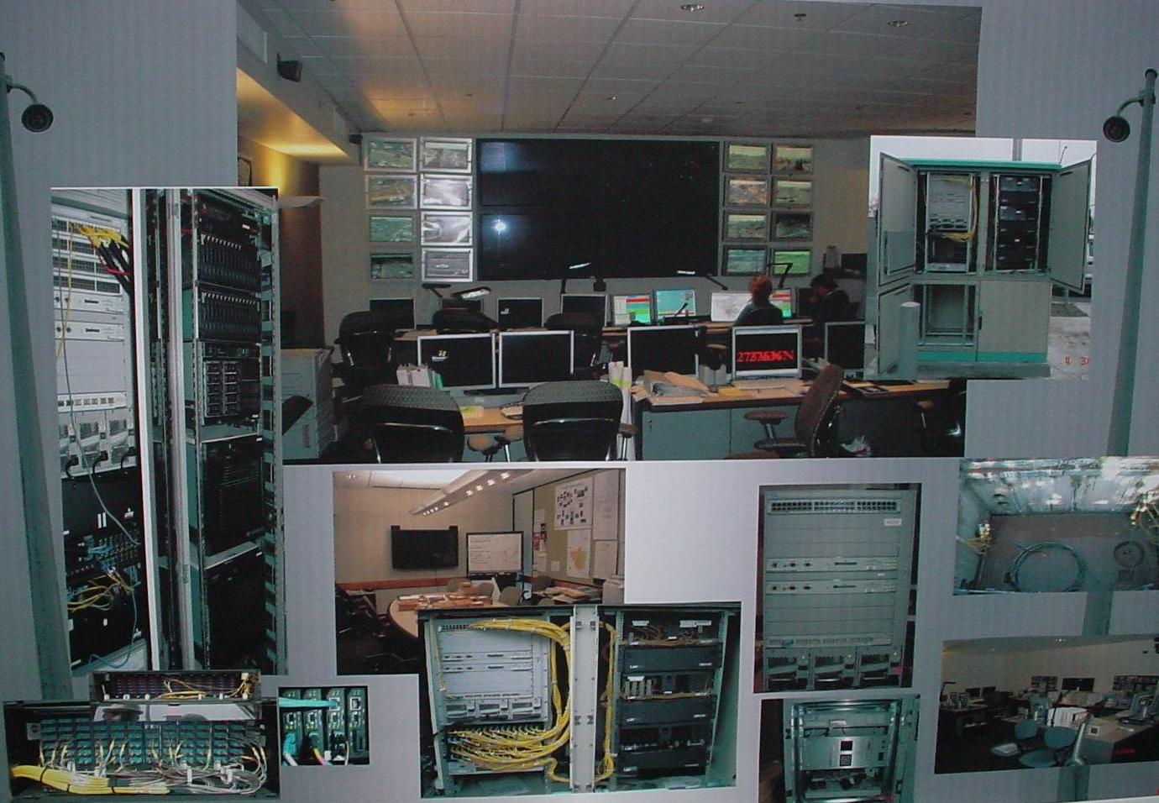
Intelligent
Transportation
Systems
Traffic Operations Center
PUBLIC WORKS DEPARTMENT
CITY OF FRESNO
Presented by:
John Stanboulian, ITS Program Manager
Shelby MacNab, Grants Administrator

Slide 2

Intelligent Transportation Systems
The application of technology to build a responsive transportation system that will effectively and efficiently move goods and people within the Fresno-Clovis Region.
1995 - National ITS Plan was published.
1998 - Congress allocated $1.2 billion for ITS related programs.
2001 - The San Joaquin Valley Intelligent Transportation System Strategic Deployment Plan was published, identifying the Fresno-Clovis Regional ITS Project and Fresno-Clovis area Signal Coordination as priority projects for Fresno County.
2015 - The Fresno County Intelligent Transportation System Strategic Deployment Plan update was published (Fresno COG).

Slide 3
Intelligent Transportation Systems
San Joaquin Valley Regional ITS Plan
“The Intelligent Transportation Vision for San Joaquin Valley is to enhance the quality of life, mobility, and the environment through coordination, communication and the integration of ITS technologies into the valley’s transportation systems”
San Joaquin Valley ITS Strategic Deployment Plan, 2001

Slide 4

Intelligent Transportation Systems
ITS Program History!
Phase1 – 1999/2001
Phase 2 – 2001/2003
Phase 3 – 2006/2007
  Blackstone Corridor Constructed.
  (124 count fiber trunk line with 6 strands at each intersection)
  Traffic Operations Center Operational
  Conduit & and Infrastructure Built
  for Herndon, Chestnut, Ventura-Kings Canyon.
  Fiber Optic Loop Installed,
  Technology Deployed &
  System Operational.
  (168 count fiber trunk line with 6 strands at each intersection)

Slide 5

Intelligent Transportation Systems
Operations & Maintenance – Today!
  ITS Program Funded (~$700k for O&M)
  Operations & Staffed with 7 Dedicated
  Maintenance ITS Staff
  ITS Standards Published (2008)
  ITS Wireless Standards Published (2009)
  Traffic Synchronization Underway!

Slide 6
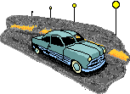
Intelligent Transportation Systems
Traffic Synchronization (Fiber) 2007-2012
Herndon Ave Synchronized Willow to Golden State
Blackstone Ave Synchronized Olive to Herndon
Kings Canyon Synchronized Downtown to Chestnut
Chestnut Ave Synchronized Kings Canyon to Shields
Clovis Ave Synchronized Shields to American
Shaw Ave Synchronized SR168 – SR 99

Slide 7
Intelligent Transportation Systems
Traffic Synchronization (Wireless) 2013-2018
  First Street Synchronized Nees to Ventura
  Nees Ave Synchronized Palm to Willow
  Bullard Ave Synchronized Marks to Willow
  Ashlan Ave Synchronized Blackstone to Peach
  McKinley Ave Synchronized SR 99 to Clovis Ave

Slide 8
Intelligent Transportation Systems
Traffic Synchronization (Wireless) 2013-2018
  West Ave Synchronized Herndon to McKinley
  Shields Ave Synchronized West Ave to Chestnut
  Tulare Ave Synchronized C Street to Clovis Ave
  Willow Ave Synchronized Ashlan to Shepherd
  Palm-Nees-Friant Synchronized Herndon to Shepherd
  Downtown Fresno St. Divisadero to G Street & to Ventura
  & Van Ness Ave

Slide 9

Intelligent Transportation Systems
Traffic Synchronization 2019-2022
Adaptive Signal Control Technology (ASCT)
  Herndon Ave ASCT Synchronized 2019/20
  Shaw Ave ASCT Synchronized 2019/20
  Ventura-Kings Canyon ASCT Construction Phase
  Friant-Blackstone ASCT Construction Phase
  Dynamic Downtown I ASCT/TSP Construction Phase
  Ashlan Avenue Time of Day Design Phase
  Jensen Ave ASCT Design Phase

Slide 10
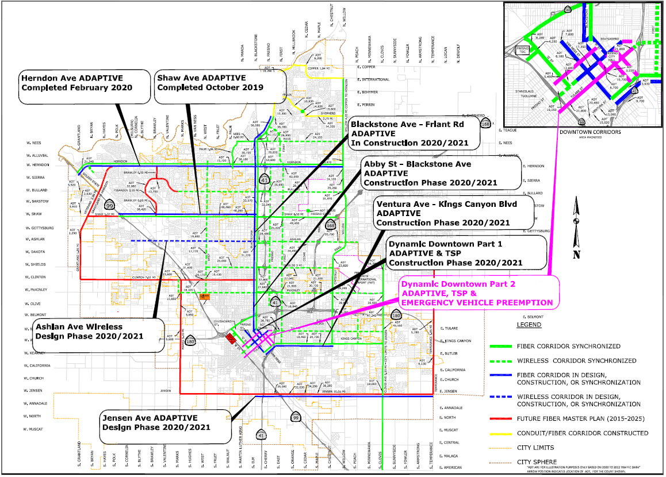
Intelligent Transportation Systems
Projects 2019 - 2022
By 2017,
~300 Traffic Signals
will be Synchronized

Slide 11
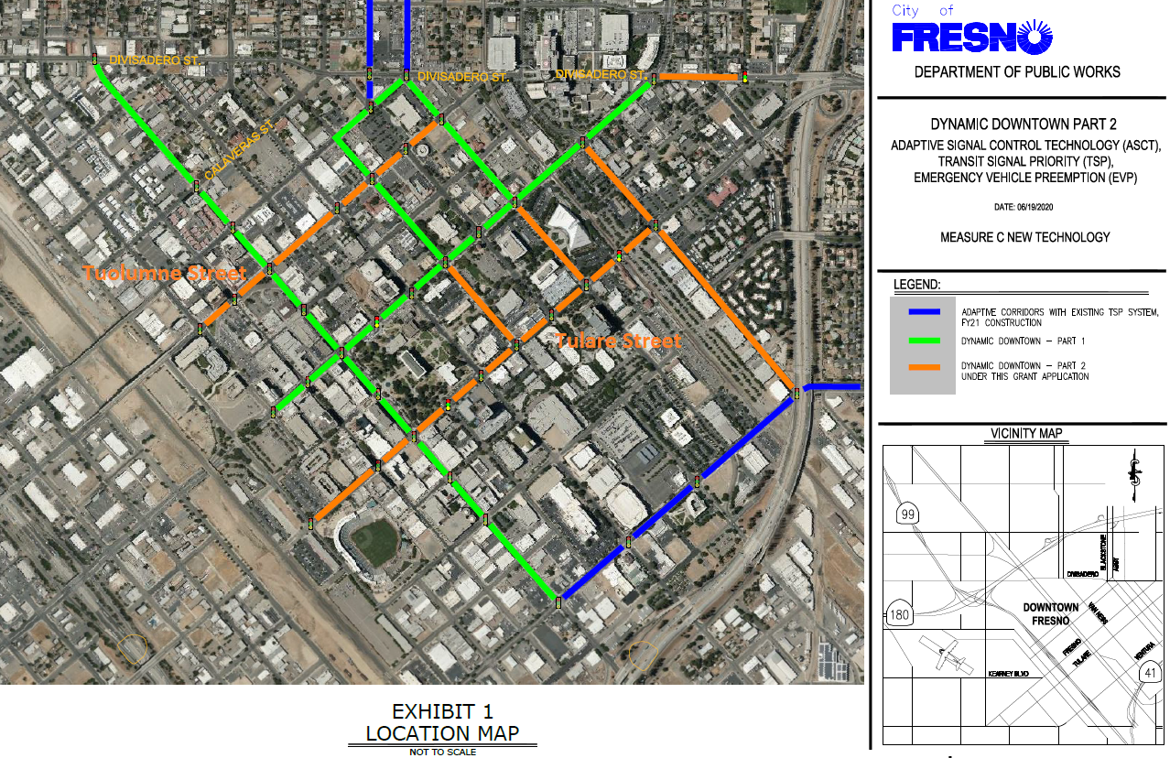
DYNAMIC DOWNTOWN ASCT TSP EVP &
SMARTCYCLE & PEDTRAX Pilot

Slide 12
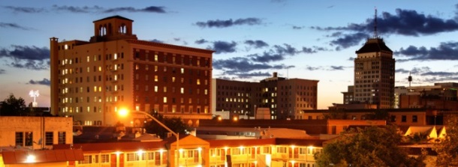

Dynamic Downtown Part 2
Presented by:
John Stanboulian, ITS Program Manager
Shelby MacNab, Grants Administrator
City of Fresno
Department of Public Works

Slide 13
Overview
Advanced Transportation Systems
Scope of Work
Locations & Costs
Need
Project Benefits
Readiness & Experience
Environmental Justice & Impacts
Innovation & Replication

Slide 14
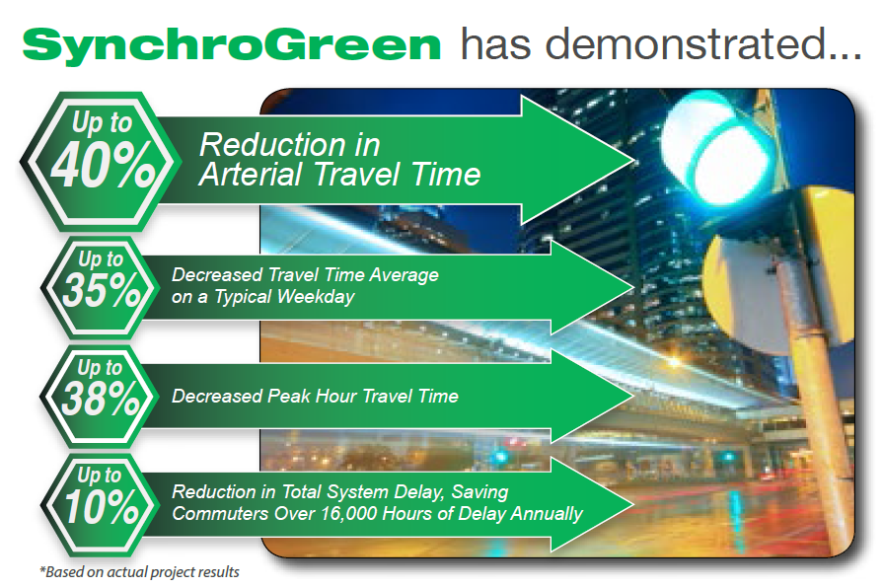
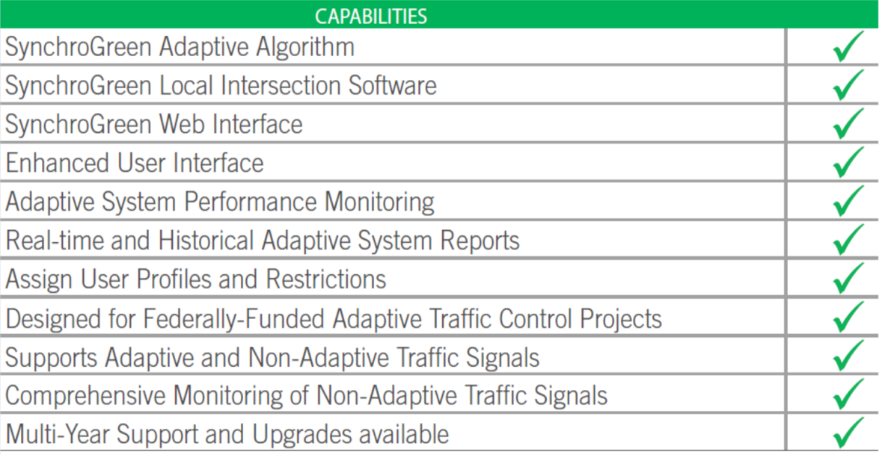
Advanced Transportation Systems
“Next Generation” ATMS & Synchro Green Adaptive Technology
Next Generation Advanced Transportation Management Systems (ATMS) & Adaptive Signal Control Technology (ASCT) with Infrastructure to Vehicle Capabilities, Pedestrian Clearance Monitoring Capabilities, Signal Performance Measures, etc.

Slide 15
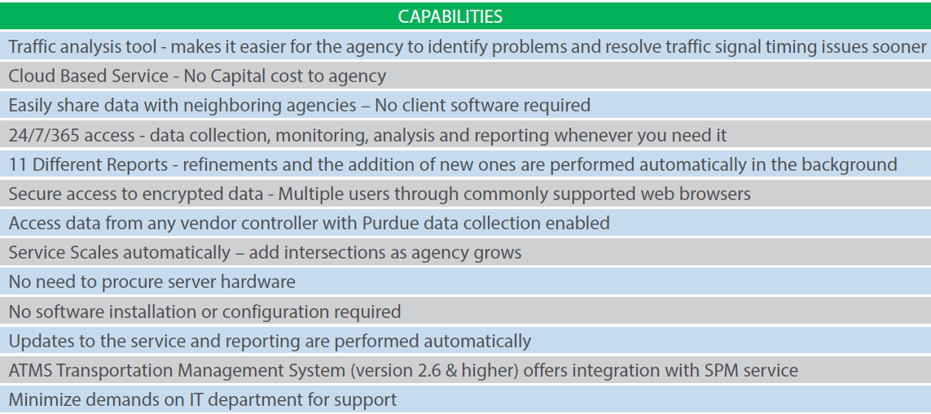
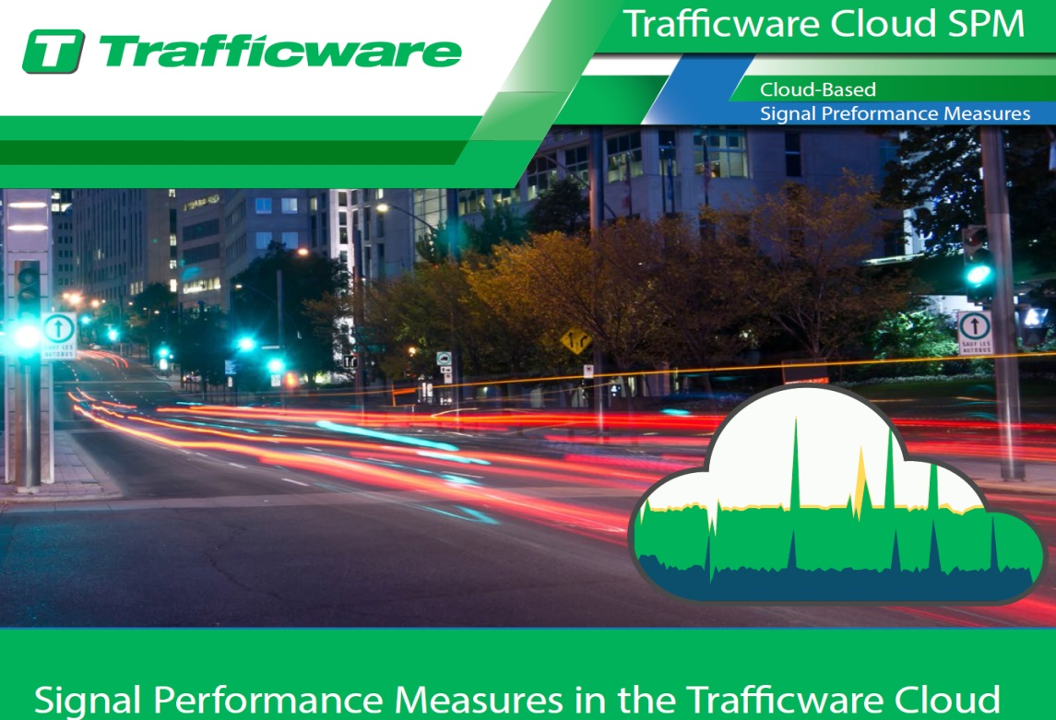
Advanced Transportation Systems
“Next Generation” Cloud Based Signal Performance Measure

Slide 16
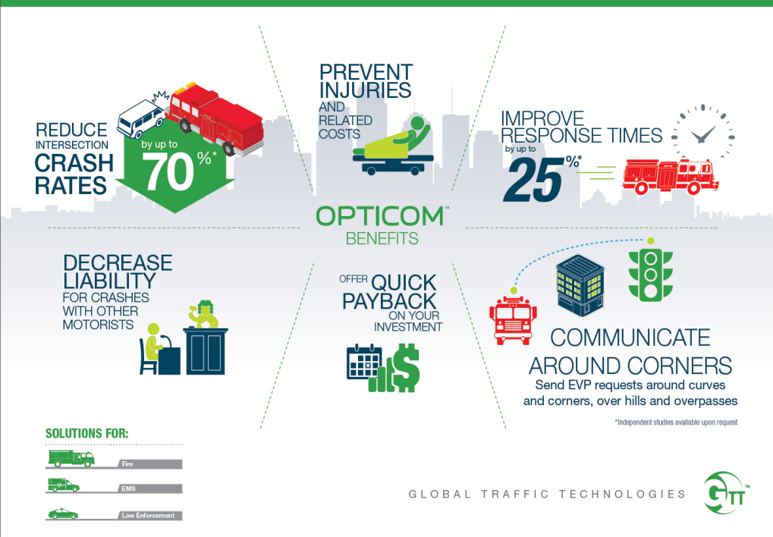
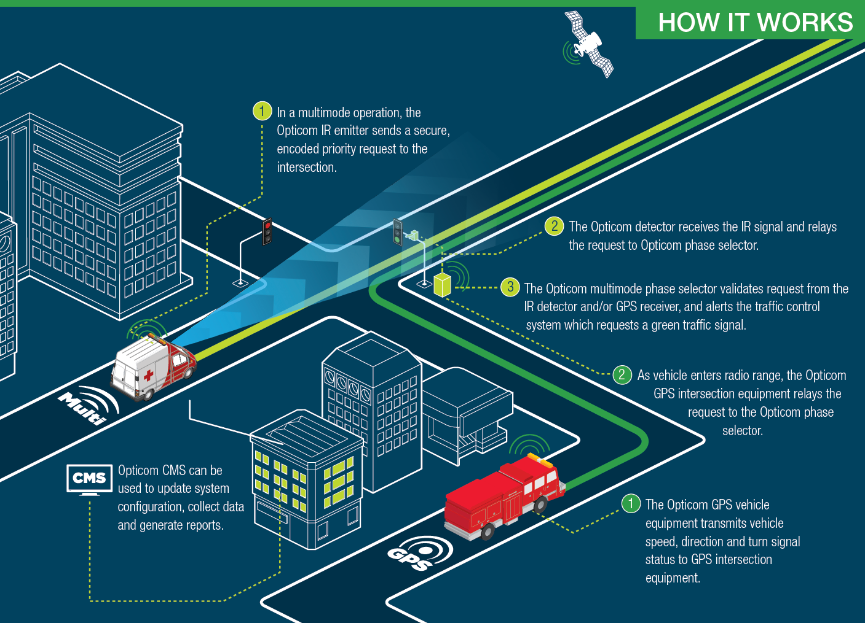
Advanced Transportation Systems
Regional Transition To GPS/RF Emergency Vehicle Preemption

Slide 17
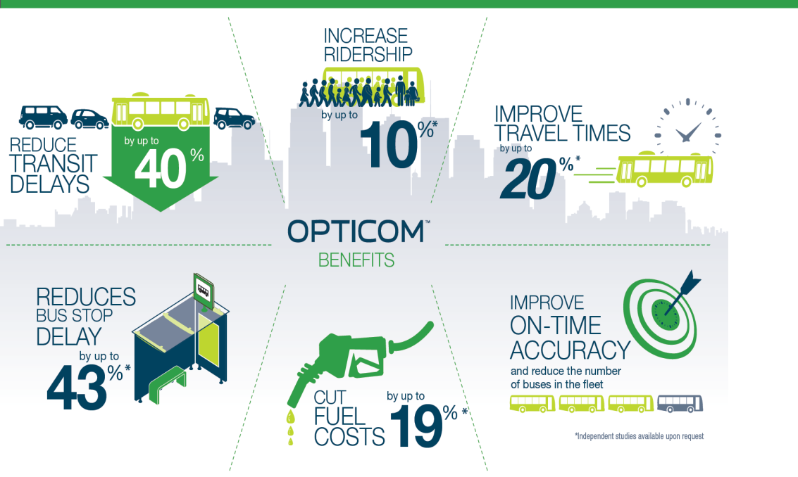
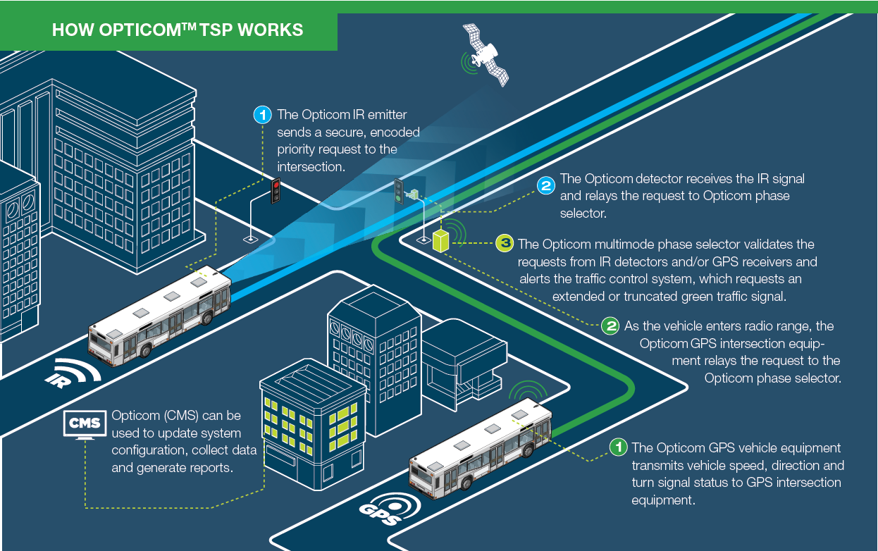
Advanced Transportation Systems
Expansion of Downtown Transit Signal Priority

Slide 18
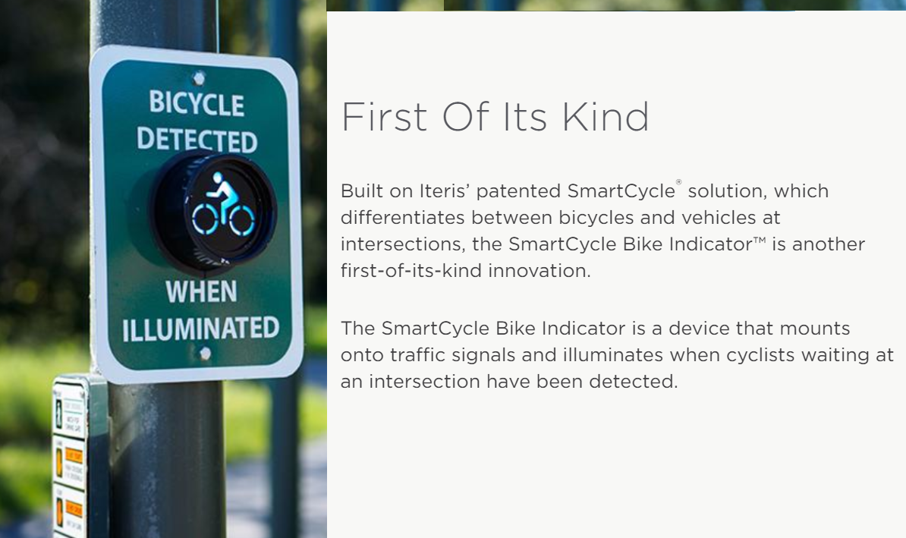
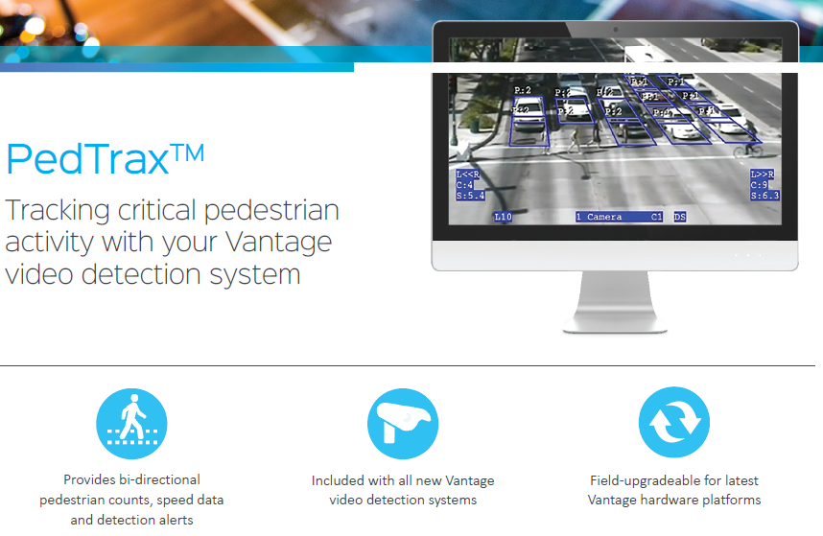
Advanced Transportation Systems
SmartCycle and PedTrax Pilot
Vehicle, Bicycle, & Pedestrian Detection & Metrics (Counts, Direction, Speed), and Crosswalk Safety (Pedestrian Green Time Extension).
Iteris Demonstration Video
https://youtu.be/UkCaVuL-L1U

Slide 19
Advanced Transportation Systems
Next Generation Technologies
Shaw Ave Adaptive System Control Technology (ASCT) was deployed in 2013.
Travel time study improvements:
  23% during AM peak (6:56 to 5:20 = 1:36 savings)
  31% during PM peak (8:17 to 5:53 = 2:34 savings)
Complaints were reduced by 1/3.
Synchro study emission reductions:
  CO 70.4 Metric Tons (MT); NOX 13.7 MT; VOC 16.3 MT
Synchro study fuel savings of 1,000,000 gallons.
Synchro Green ASCT System Engineering (SE) was approved by Caltrans & FHWA.
Fresno County ITS SDP (2015) incorporates Citywide Advanced Transportation Management System.
Dynamic Downtown Part 1 will deploy & validate the interoperability of ASCT, TSP & New video vehicle detection systems.
Dynamic Downtown Fresno Part 2 will deploy & validate the interoperability of “Next Generation” technologies of ATMS, ASCT, TSP, EVP, PedTrax, SmartCycle.

Slide 20
Scope of Work
The proposed project will
Deploy ATMS & ASCT Systems, and controller modules at 15 signals (Next Generation New Technology);
    Install Video detection & cameras.
Deploy GPS Emergency Vehicle Preemption System at 15 signals (Central Valley Transition to New Technology);
    Install EVP equipment on limited Fire & PD vehicles for validation.
Deploy Transit Signal Priority at 15 signals
(Expansion of Transit Signal Priority);
    Install TSP equipment on limited Transit buses along proposed routes.
Deploy Bicycle & Pedestrian Detection System at Tulare Street and P Street traffic signal (Next Generation New Technology);
System Engineer & validate interoperability of ATMS, ASCT, TSP, EVP, SmartCycle & PedTrax Systems (Next Generation New Technology).

Slide 21
Locations & Cost
Tulare Street from R Street to H Street.
Tuolumne Street from P Street to Broadway Street.
Divisadero Street from Fresno Street to Mariposa Street.
Cost for Next Generation Advanced Transportation Systems @ 15 Signals Downtown: $2,500,000. (Actually, It’s priceless! This project will launch several next generation technologies for the Central Valley).

Slide 22
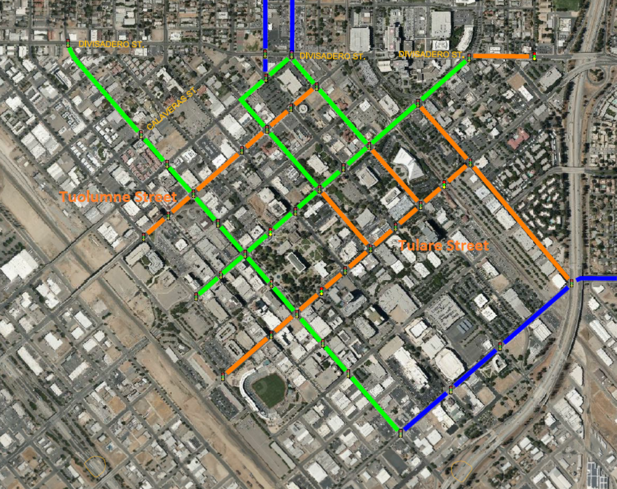
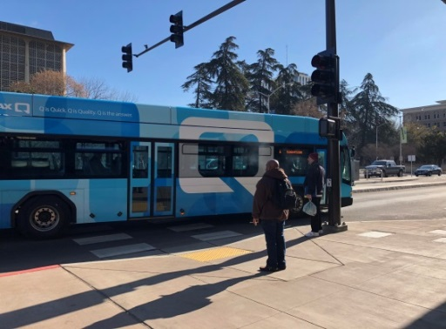
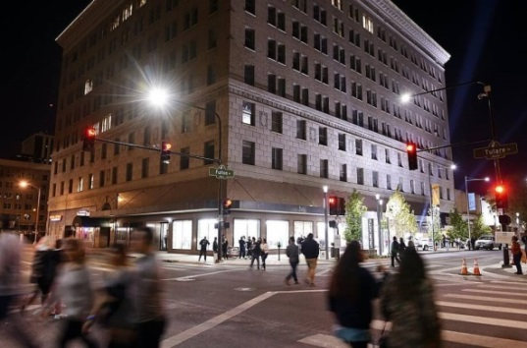
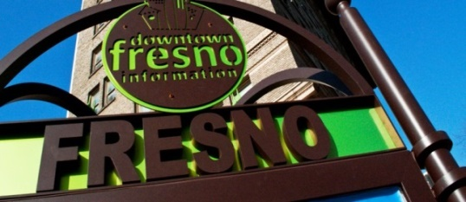
Project Area

Slide 23
Need
Dynamic Downtown Part 2 Project will deploy the latest versions of ATMS & ASCT, inlcuding Infrastructure-to-Vehicle Systems, and cloud based Signal Performance Measures.
EVP/TSP deployment will demonstrate and support the transition from 20+ year old optical EVP Systems to modern GPS/Radio Frequency EVP Systems.
Bicycle & pedestrian detection systems will demonstrate the latest application of new technologies for pedestrian safety at traffic signals.
Dynamic Downtown Part 2 is an essential project that will System Engineer, and upon successful Validation of new technologies, will introduce new ITS Standards.

Slide 24

Project Benefits
Reduces Greenhouse Gas Emissions 849 lbs./year. Fresno COG, Emission Calculation Guidelines (2005 ARB Guidance)
Improve safety & reliability of the transportation system.
Optimize on-time-performance of Transit, potentially increasing ridership.
Validate “Next Generation” technology & introduce City of Fresno new ITS Standards.
Support economic vitality, local transportation professional education & development.

Slide 25
Readiness & Experience
City’s ITS Program has successfully designed, constructed, and synchronized 14 ITS corridors, and 6 additional ITS projects are in design or in construction.
The fiber traffic network is complete, synchronizing ~142 traffic signals.
The wireless traffic network is complete, synchronizing ~159 traffic signals.
Transit Signal Priority (TSP) System is expanding:
  BRT – ~70 Signals.
  Shaw Ave TSP in construction - ~30 Signals.
The City’s ITS Program is ready for new Central Valley technologies:
  Next Generation ATMS/ASCT Systems,
  Transit Signal Priority &
  Net Generation Emergency Vehicle Preemption integration,
  Next Generation SmartCycle & PedTrax pilot.

Slide 26
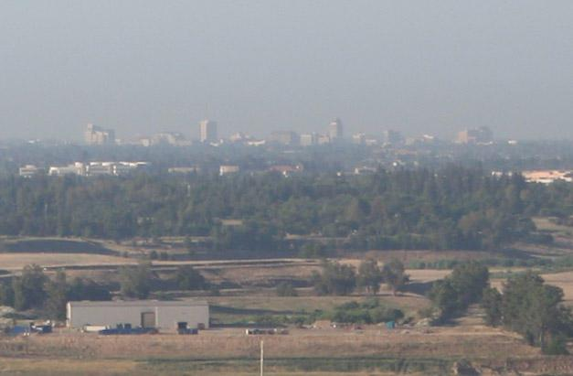
Environmental Justice
The asthma rate in the project area is higher than 78-97% of the census tracts in CA.
BRT optimization provides reliable connections to important social services.

Slide 27

Innovation & Replication
Dynamic Downtown Part 2 is applied research & demonstration project.
Results/outcomes from the project will provide best practices for future grants.
Establish Standards & Specifications – shared regionally.

Slide 28
QUESTIONS?

Slide 29
Intelligent Transportation Systems
Projects 2019 - 2022
By 2017,
~300 Traffic Signals
will be Synchronized

Slide 30
DYNAMIC DOWNTOWN ASCT TSP EVP &
SMARTCYCLE & PEDTRAX Pilot

